Slide 1
Programming and Computational Finance
Group 7 Presentation

Slide 2
Part 1
Sumedha and Duy Hung

Slide 3
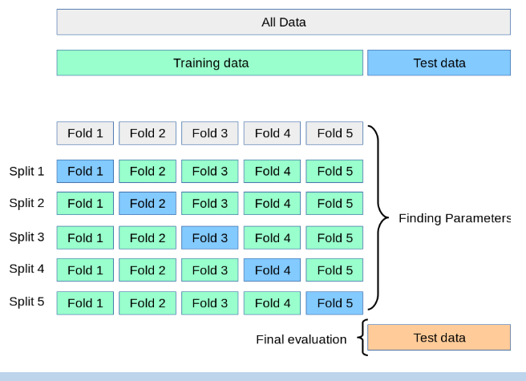
K-Fold Cross Validation
K-Fold CV is where a given data set is split into a K number of sections/folds where each fold is used as a testing set at some point.

Slide 4
“Hyperparameters improve the performance of the model via its behavior complexity or its learning rate. Models can have many hyper-parameters and finding the best combination of parameters can be viewed as a searching problem."
— Dao Duy Hung circa 2022

Slide 5

Hyperparameters Steps
Define a model
Define the range of possible values for all hyperparameters
Define a method for sampling hyperparameter values
Define an evaluative criteria to judge the model
Define a cross-validation method

Slide 6
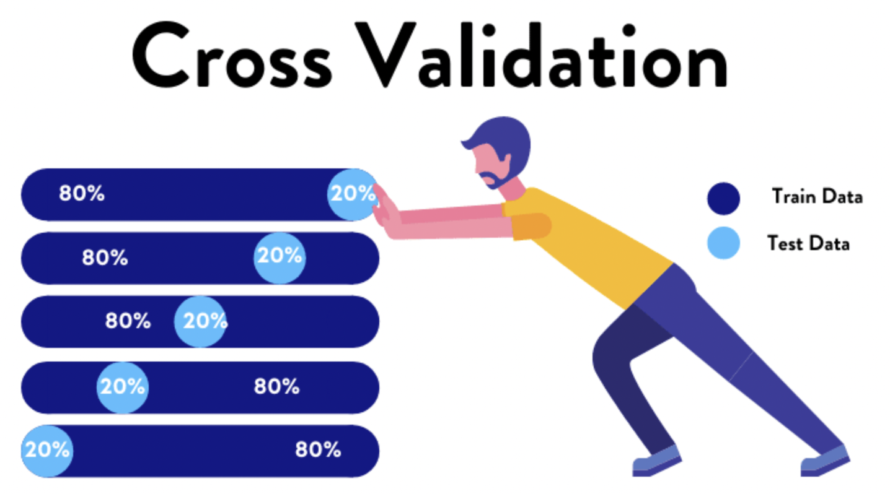
Cross Validation (CV)
K-fold cross validation
Resampling method that uses different portions of the data to test and train a model on different iterations
Use to compare and select models

Slide 7
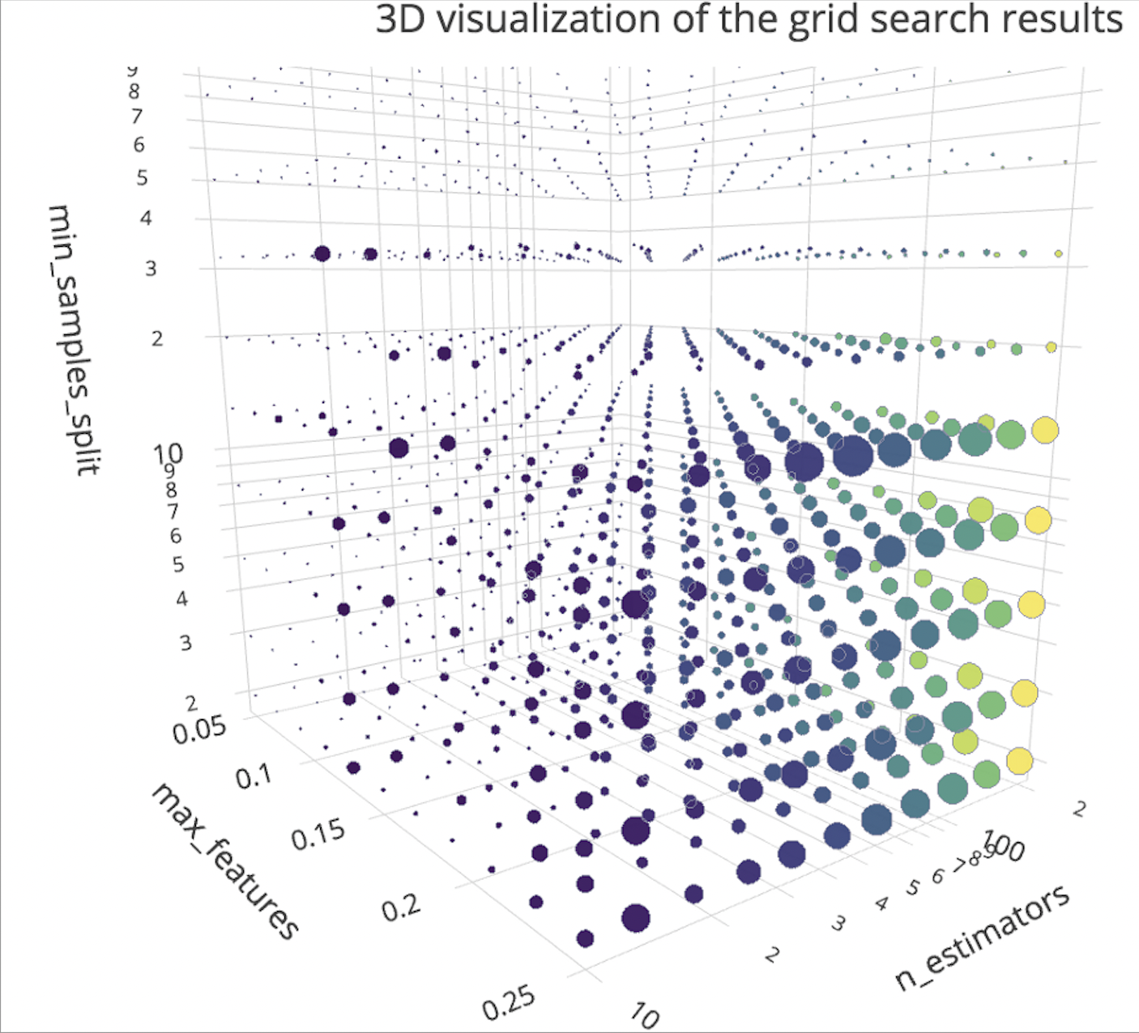
GridsearchCV from Sklearn
Grid search picks out a grid of hyperparameter values
Build a model for each possible combination of all the hyperparameter values provided
GridsearchCV function evaluates every one of them and returns the winner by selecting the architecture which produces the best results.

Slide 8
What models getting Hyper-tuned?
ARIMA
LASSO
Support Vector Machine (SVM)
Elastic Nets (EN)

Slide 9
Part 2
Stephen and Borui Tian

Slide 10
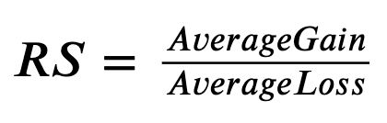
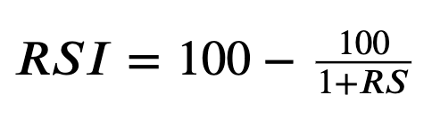
Relative Strength Index (RSI)
A momentum indicator that measures the speed and magnitude of a security's recent price changes
RSI is displayed as an oscillator (a line graph)
Evaluates overvalued or undervalued conditions in the price of a security.
Indicates securities that may be primed for a trend reversal or corrective pullback
Not reliable as a standalone indicator in trending markets

Slide 11
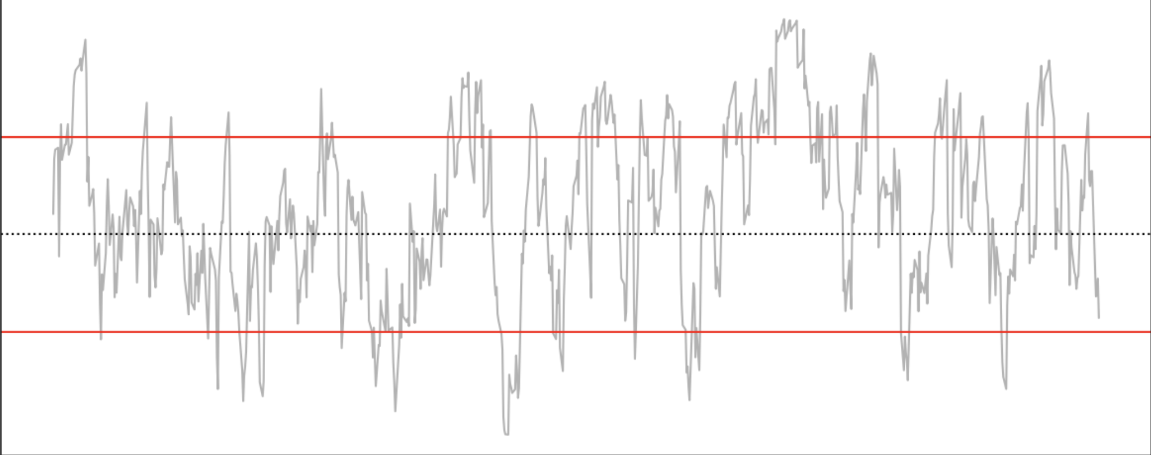
RSI Strategy Requirements
Signals
Long
Short
Restriction ( ! )
Exit Long
Exit Short
Long & Shorts are permitted
Enter once RSI crosses 30 from below
Enter once RSI crosses 70 from above
Only one open position at a time
Once RSI crosses 50 from below
Once RSI crosses 50 from above

Slide 12
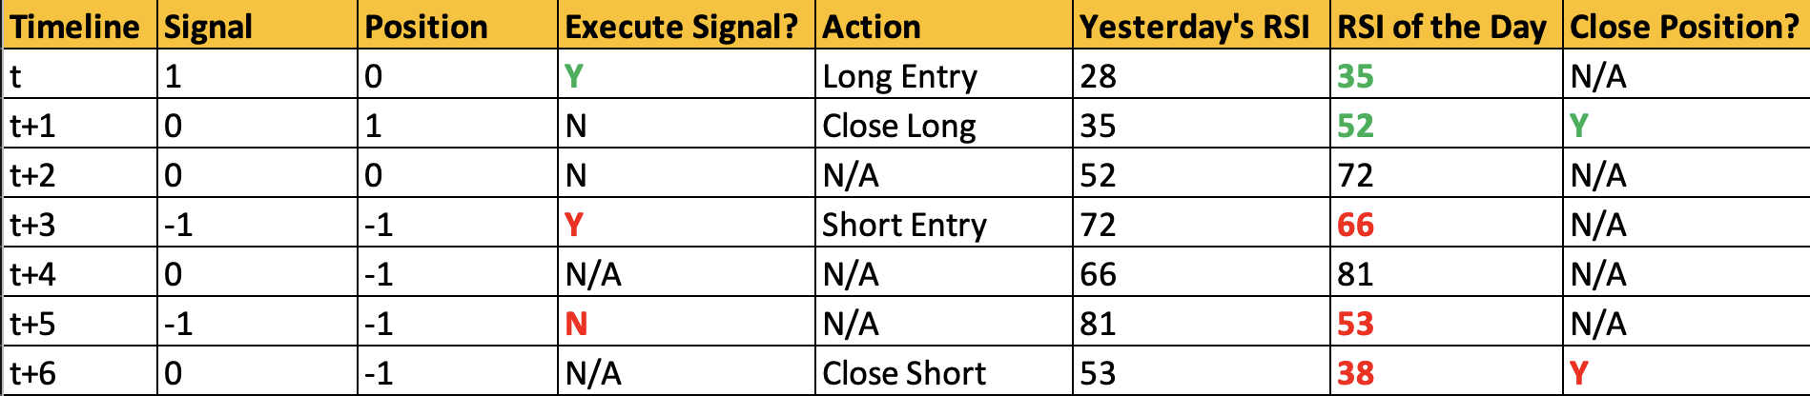
RSI Strategy Scenarios

Slide 13
PCA
Part 3
Cassidy and Yurou

Slide 14
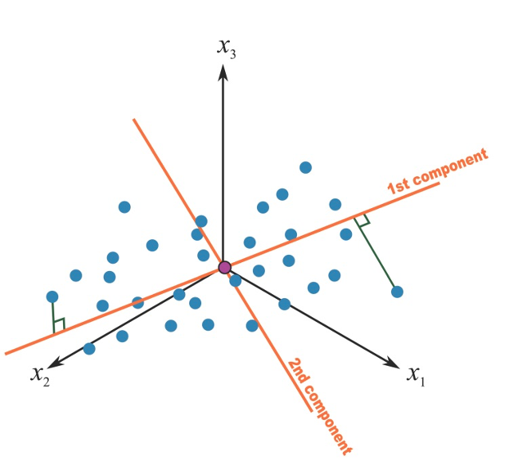
Principal Component Analysis (PCA)
What is it ?
A popular technique for analyzing large datasets containing a high number of dimensions/features per observation, increasing the interpretability of data while preserving the maximum amount of information, and enabling the visualization of multidimensional data.

Slide 15
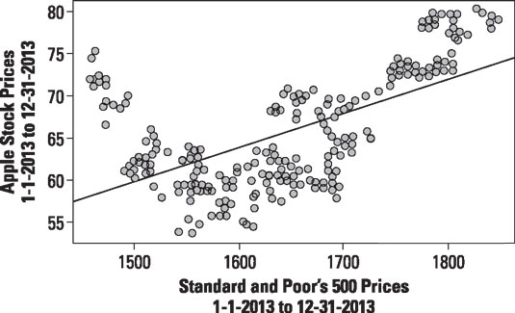
PCA – Correlation
Finding the relationship between the stock price and the price of the index

Slide 16
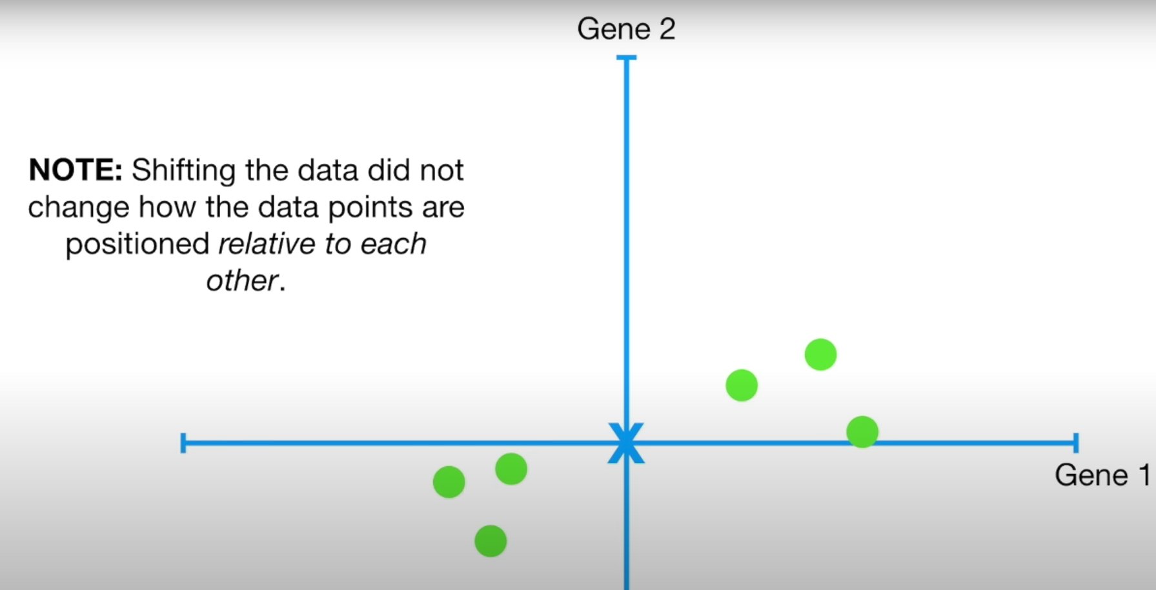

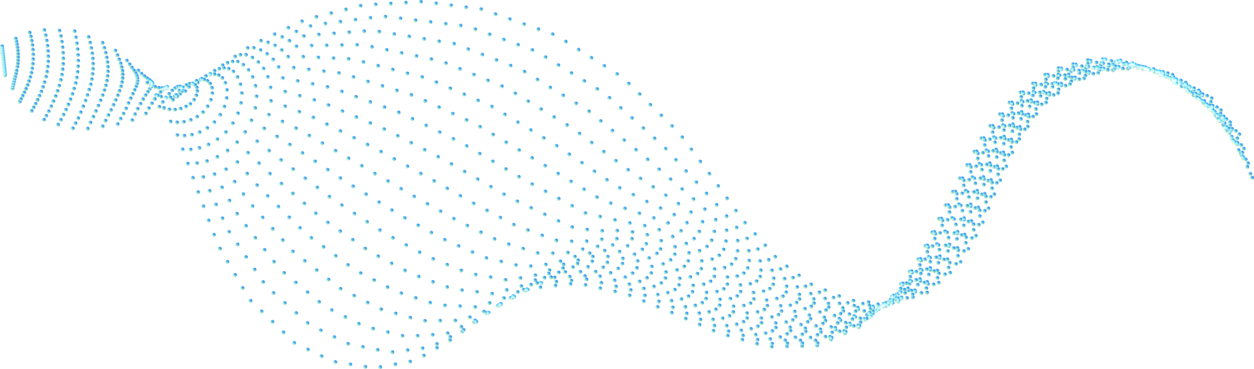

PCA – Centering the point
Finding the average of Apple stock price
Find the average of S&P 500 price
Finding the average of these 2 averages and align it to the origin

Slide 17
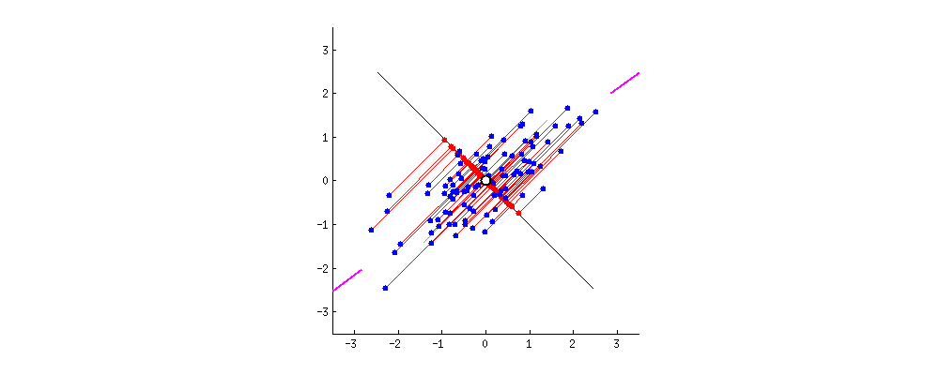
PCA – Best Fit line
The stock prices are projected onto a best fit line, and the distance from the data to the line is measured.
The algorithm is trying to maximize the distance (Sum of squared distance) of the projected points to the origin.

Slide 18
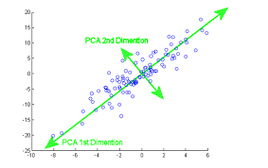
PCA - Principal Component
Eigenvectors with the largest eigenvalues correspond to the dimensions that have the strongest correlation in the dataset. (PC 1)
All the principal components are perpendicular to one another

Slide 19
PCA – In a nutshell
Correlation
Center the points
Best Fit line
What is the relationship between Stock A and Stock B?
Find the average of the relationship between both stocks and shift it to the origin
The returns of the stocks is projected onto best fit line

Slide 20
PCA – In a nutshell
Eigenvalues/Eigenvectors
Principal Component
Eigenvectors with the largest eigenvalues correspond to the dimensions that have the strongest correlation in the dataset.
Projecting the different stocks (i.e more than 2 different stocks) onto principal components
Notes:
We are projecting the 30 stocks (Market cap weighted) into our principal

Slide 21
PCA – In a nutshell
PCA removes noise by reducing a large number of features to just a few number of principal components.
Notes:
We are projecting the 30 stocks (Market cap weighted) into our principal

Slide 22

THE END
Thank You For Listening! Have A Nice Day

